Slide 1

Unsupervised Learning
Presented by:
Elizer Ponio Jr.
Department of Computer Science
College of Computing and Information Technologies

Slide 2

Outline
What is Unsupervised Learning?
Supervised vs Unsupervised Learning
Clustering
Types of Clustering
Notes:
Have you asked yourself the question, why do people organize?
Lets go to the psychology of organizing
This predictability applies within the context of our homes, manifesting through the concept of organization

Slide 3
What is Unsupervised Learning?
Unsupervised Learning is a type of machine learning that focuses on finding patterns on unlabeled data to enable models to make predictions or decisions.
Notes:
Have you asked yourself the question, why do people organize?
Lets go to the psychology of organizing
This predictability applies within the context of our homes, manifesting through the concept of organization

Slide 4
What is Unsupervised Learning?
Unlabeled data doesn’t have a fixed output variable. The model learns from the data, discovers the patterns and features in the data, and returns the output.
Notes:
Have you asked yourself the question, why do people organize?
Lets go to the psychology of organizing
This predictability applies within the context of our homes, manifesting through the concept of organization

Slide 5
What is Unsupervised Learning?
Supervised vs Unsupervised Learning
Clustering
Types of Clustering
Notes:
Have you asked yourself the question, why do people organize?
Lets go to the psychology of organizing
This predictability applies within the context of our homes, manifesting through the concept of organization

Slide 6
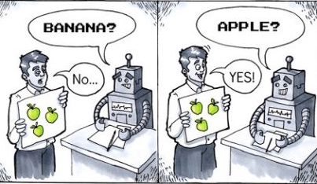
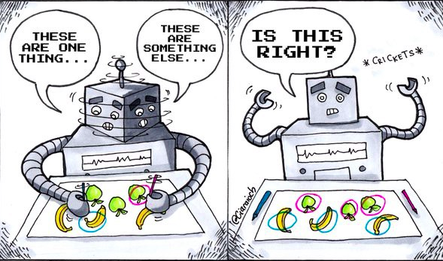
Supervised vs Unsupervised Learning
Supervised Learning
Unsupervised Learning
Notes:
Have you asked yourself the question, why do people organize?
Lets go to the psychology of organizing
This predictability applies within the context of our homes, manifesting through the concept of organization

Slide 7



Supervised vs Unsupervised Learning
Supervised Learning | Unsupervised Learning
Computer learns by making use of labeled data | Computer learns by making use of unlabeled data
Requires manual annotation of data | Does not require annotation of data
Apple
???
Mango
Grapes
???
???
Notes:
Example of unsupervised learning:
Cluster books into different categories on the basis of the title and other book information but not by knowing its actual category

Slide 8
Human Features Dataset
 | Height | Body Type | Eye Color | Skin Complexion | Label
0 | Tall | Chubby | Blue | Light | ???
1 | Average | Slim | Brown | Fair | ???
2 | Short | Petite | Green | Dark | ???
Features
Unknown
Notes:
Have you asked yourself the question, why do people organize?
Lets go to the psychology of organizing
This predictability applies within the context of our homes, manifesting through the concept of organization

Slide 9
Iris Dataset
 | Sepal Length | Sepal Width | Petal Length | Petal Width | Species
0 | 5.1 | 3.5 | 1.4 | 0.2 | ???
1 | 5.7 | 2.8 | 4.1 | 1.3 | ???
2 | 6.3 | 3.3 | 6 | 2.5 | ???
Features
Unknown
Notes:
Have you asked yourself the question, why do people organize?
Lets go to the psychology of organizing
This predictability applies within the context of our homes, manifesting through the concept of organization

Slide 10
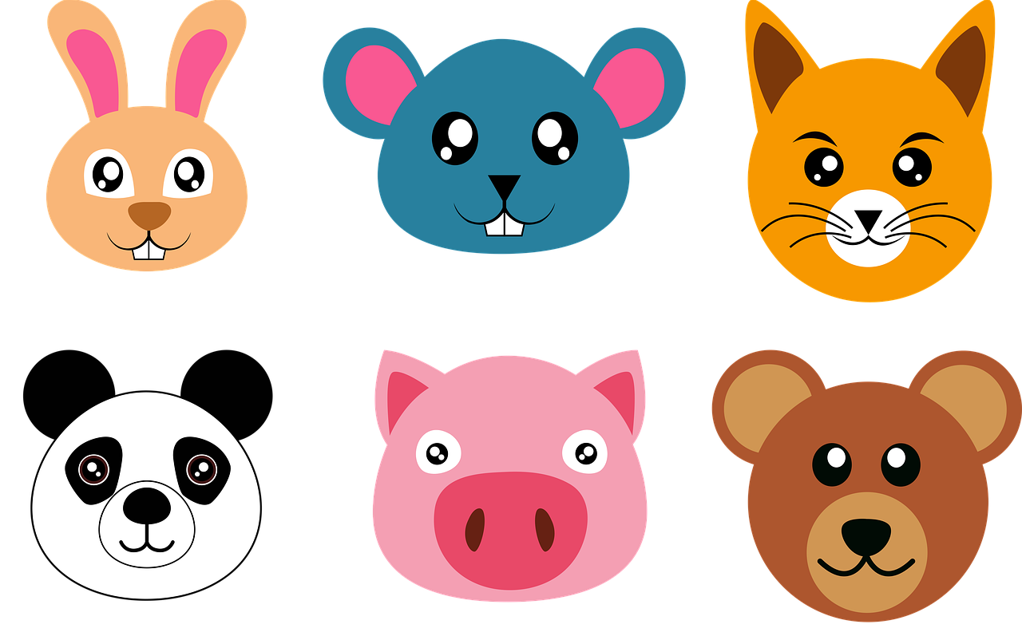
Unlabeled Data
???
???
???
???
???
???
Notes:
Have you asked yourself the question, why do people organize?
Lets go to the psychology of organizing
This predictability applies within the context of our homes, manifesting through the concept of organization

Slide 11

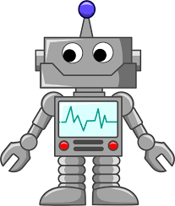
If the data is not labeled, how is the model learning?
????
Notes:
Have you asked yourself the question, why do people organize?
Lets go to the psychology of organizing
This predictability applies within the context of our homes, manifesting through the concept of organization

Slide 12


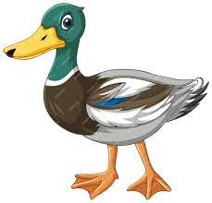
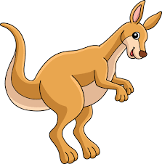
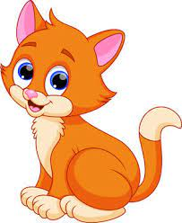
Group with wings
Group with two legs
Model
Group with four legs
Notes:
Have you asked yourself the question, why do people organize?
Lets go to the psychology of organizing
This predictability applies within the context of our homes, manifesting through the concept of organization

Slide 13
What is Unsupervised Learning?
Supervised vs Unsupervised Learning
Clustering
Types of Clustering
Notes:
Have you asked yourself the question, why do people organize?
Lets go to the psychology of organizing
This predictability applies within the context of our homes, manifesting through the concept of organization

Slide 14
Clustering
Grouping a set of objects in such a way that similar objects fall into the same group.
Method of grouping similar entities together
Similar objects are grouped into one cluster and are different from objects in another cluster.
Notes:
Have you asked yourself the question, why do people organize?
Lets go to the psychology of organizing
This predictability applies within the context of our homes, manifesting through the concept of organization

Slide 15
Why Clustering is Important?
Through the use of clusters, attributes of unique entities can be profiled easier. This can subsequently enable users to sort data and analyze specific groups.
It can help in dimensionality reduction if the dataset is comprised of too many variables. Irrelevant clusters can be identified easier and removed from the dataset.
Notes:
Have you asked yourself the question, why do people organize?
Lets go to the psychology of organizing
This predictability applies within the context of our homes, manifesting through the concept of organization

Slide 16
Types of Clustering
K-Means
Hierarchical Clustering
Density-Based Spatial Clustering of Applications with Noise (DBSCAN)
Notes:
Have you asked yourself the question, why do people organize?
Lets go to the psychology of organizing
This predictability applies within the context of our homes, manifesting through the concept of organization

Slide 17

Applications
Malware Clustering
Book Clustering
Notes:
Have you asked yourself the question, why do people organize?
Lets go to the psychology of organizing
This predictability applies within the context of our homes, manifesting through the concept of organization

